Slide 1
Dublin Maths Camp
April, UCD, Dublin
Instructor: Dr. Lan K. Nguyen
Systems Biology Ireland

Slide 2
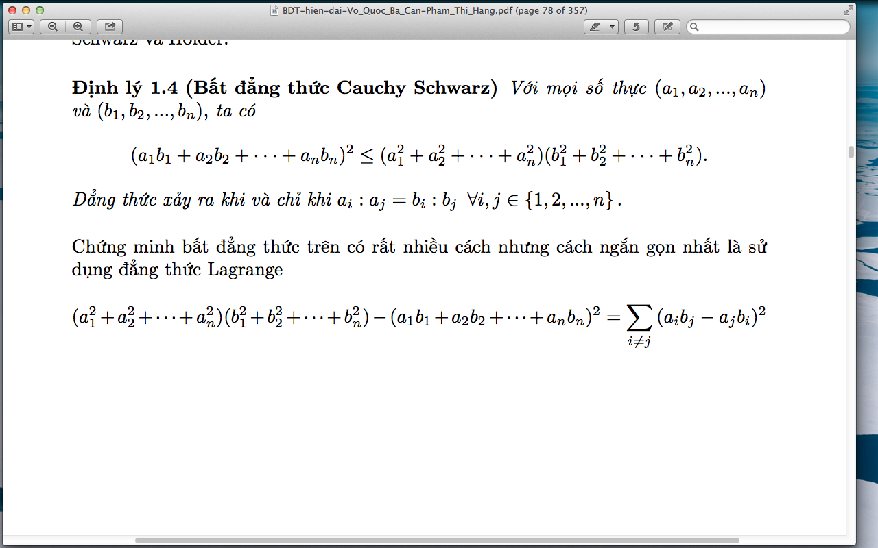
The Cauchy–Schwarz Inequality
In n-dimension
For all real numbers a₁, a₂, …, a_{n} and b₁, b₂, …, b_{n} we have:
Equality occurs if and only if:
Most simple proof is to use the Lagrange:
In 2-dimension

Slide 3
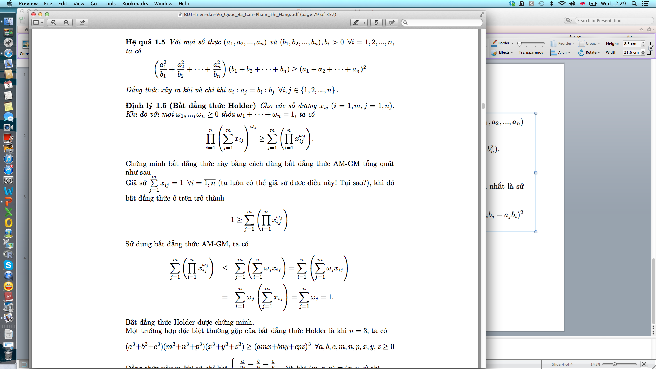
A useful consequence:
For all real numbers a₁, a₂, …, a_{n} and b₁, b₂, …, b_{n}
we have:
Equality occurs if and only if:

Slide 4
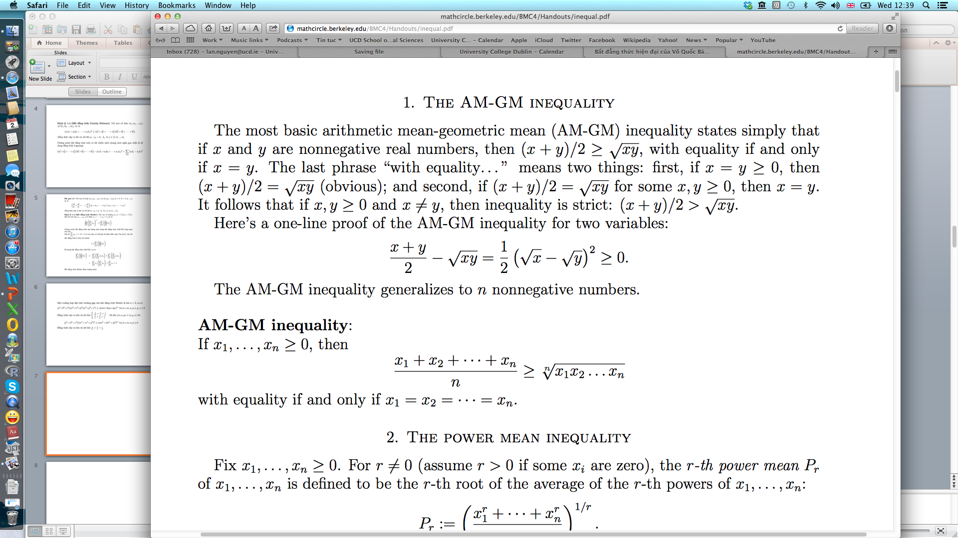
The AM-GM Inequality

Slide 5
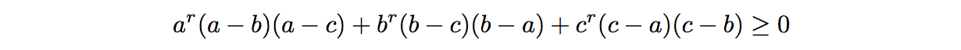
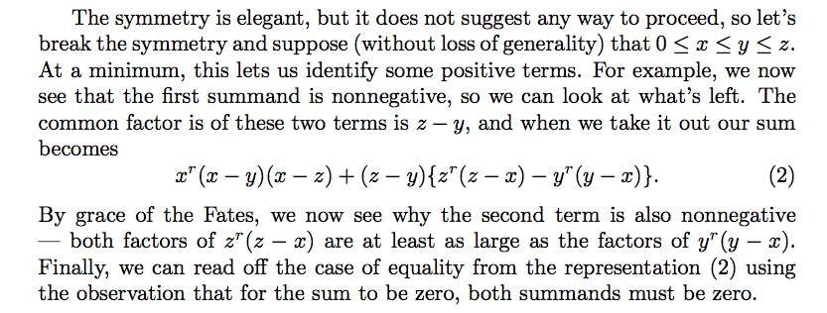
The Schur Inequality
For the real numbers a, b, c. Then for all r > 0, we have
and equality occurs if and only if: a = b = c OR a = b, c = 0 or any similar combinations.

Slide 6
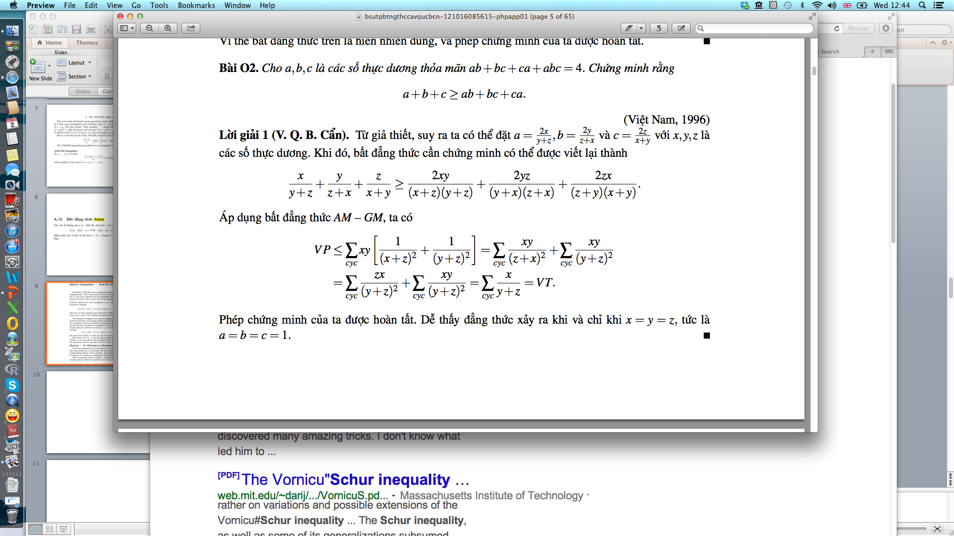

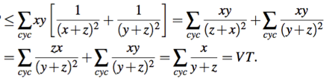
Problem 1
For the positive real numbers a, b, c satisfying:
Prove that:
Solution 1:
From the given condition for a, b, c, with some observations we can put (where x, y, z are real positive numbers):
The inequality to be proved can be re-written as:
Using AM-GM, we have the RHS:
LHS
Easy to see equality occurs if and only if x = y = z or a = b = c =1

Slide 7
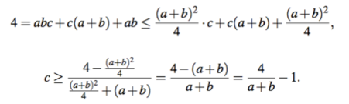
Solution 2:
It is easy to see that among a, b, c there exists at least two of them such that their difference to 1 have the same sign (positive or negative). Why???
Suppose they are a and b, then we have:
which leads to:
However, applying AM-GM, we have:
Thus
Then
Combined with above, we get
or

Slide 8


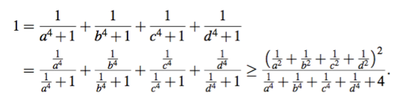




Problem 2
For any positive real numbers a, b, c and d such that
Prove:
Solution 1:
Applying Cauchy Schwarz, we have:
This means:
and
In addition, following AM-GM we have:
Combined together, we have abcd >= 3.
Equality occurs if and only if:

Slide 9






Solution 2:
Let
then we have
and
To prove abcd >= 3, we need to prove that:
However, this is trivially true due to AM-GM, hence:
And the proof is done!!!

Slide 10
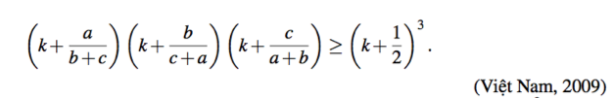





Problem 3 (home work)
For any positive real numbers a, b, c, find all k such that the following inequality is true
Solution:
First, let a = b = c =1, the inequality becomes: or
Now we let c -> 0, then the inequality holds only if:
We’ll now prove that the roots of this new inequality will be all k that satisfy the problem’s condition or
(1)
Now, let
then and (1) becomes
Applying AM-GM we get:

Slide 11
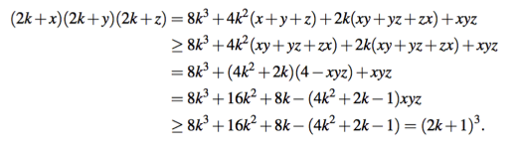
NOW, if we reuse the result of Problem 1 then we have:
Thus, our proof is completed. This means that our hypothesis above is correct, that all k to be identified are roots of
You can easily solve this and find k.

Slide 12
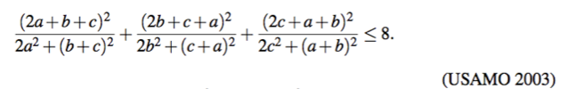





Problem 4 (home work)
For any positive real numbers a, b, c. Prove:
Solution 1:
Observe that: so we can rewrite the above inequality to be:
According to Cauchy Schwarz:
Thus, we only need to prove:
However, this comes from and other two similar expressions,
which are again a consequence of Cauchy Schwarz ( you can appreciate that C-S is extremely powerful)
Our proof is finished, it’s easy to see that equality occurs if and only if a =b = c.

Slide 13


Solution 2:
The to-be-proved is an inequality with zero “degree”, thus we can assume: a + b + c =1
which converts the inequality to:
Now, a bit of (clearer) transformation:
We obtain:
which is the proof.

Slide 14


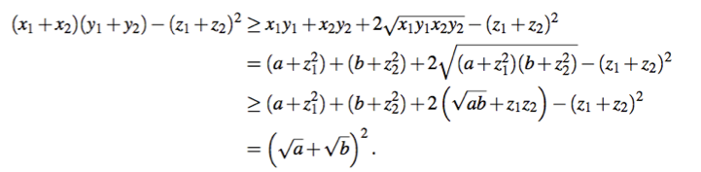

Problem 5 (home work)
Given x1, x2, y1, y2, z1, z2 are real numbers such that: x1, x2 >0, x1 y1 > z1²and , x2 y2 > z2²
Prove:
Solution 1:
From given conditions, we can see that y₁ and y₂ are positive. This allows us to apply AM-GM to obtain:
Now, let: and we have
Thus, to obtain the proof we just need to show
which is trivial according to AM-GM…

Slide 15

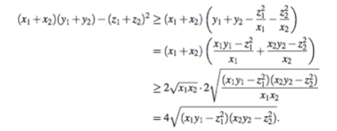



Solution 2:
Applying Cauchy-Schwarz we have:
leading to
On the other hand, following AM-GM we have
Thus
Which means
And done…..

Slide 16



Problem 6 (home work)
For all positive real a, b, c, d. Prove that:
(candidate problem, IMO 1971)
Solution:
Applying AM-GM, we have:
Similarly, we also have:
Add the corresponding sides of these two inequalities, we obtain our proof.
Equality occurs if and only if a=c and b=d.

Slide 17



Further Problems
Problem 7. For all positive real a, b, c such that and x, y, z are arbitrary real positive numbers. Prove that:
(Austria Olympics, 1971)
Problem 8. Given a, b and c are non-negative real numbers such that no two can be equal to 0 simultaneously, and that a+b+c =1. Prove that:
(Vietnamese team selection round for IMO 2009)
Problem 9. Given a, b, c, d are positive real numbers satisfying: a b c d = 1 and
a + b + c + d > P Prove that:
(candidate problem, IMO 2008)

